Slide 1

In-Vehicle Coupon Recommendation Dataset
MACHINE LEARNING PROJECT 1
UNIVERSITY OF WINDSOR
Prepared By:
Meher Jyothi Karpurapu - 110070739
Nikhilesh - 110057906
Janani Suresh Kumar - 110071944

Slide 2
Introduction
Data contains different driving scenarios including the destination, current time, weather, passenger, etc., along with driver background like occupation, income, etc.
Dataset specifies whether the driver would accept the coupon or not
Enhancement of Marketing efforts to maximize revenue
Can be used for targeted marketing campaigns based on customer background
Overview of dataset:
strong
destination | passanger | weather | coupon | expiration | gender | occupation | income | Bar | CoffeeHouse | CarryAway | … | Y
Work | Alone | Sunny | Restaurant(<20) | 1d | Male | Management | $87500 - $99999 | less1 | 1~3 | 1~3 | … | 1
No Urgent Place | Friend(s) | Sunny | Restaurant(20-50) | 1d | Male | Protective Service | $25000 - $37499 | never | never | gt8 | … | 0
Home | Alone | Sunny | Coffee House | 2h | Male | Management | $25000 - $37499 | 4~8 | gt8 | gt8 | … | 1
Work | Alone | Sunny | Restaurant(<20) | 1d | Female | Education&Training&Library | $87500 - $99999 | 1~3 | 1~3 | less1 | … | 0

Slide 3
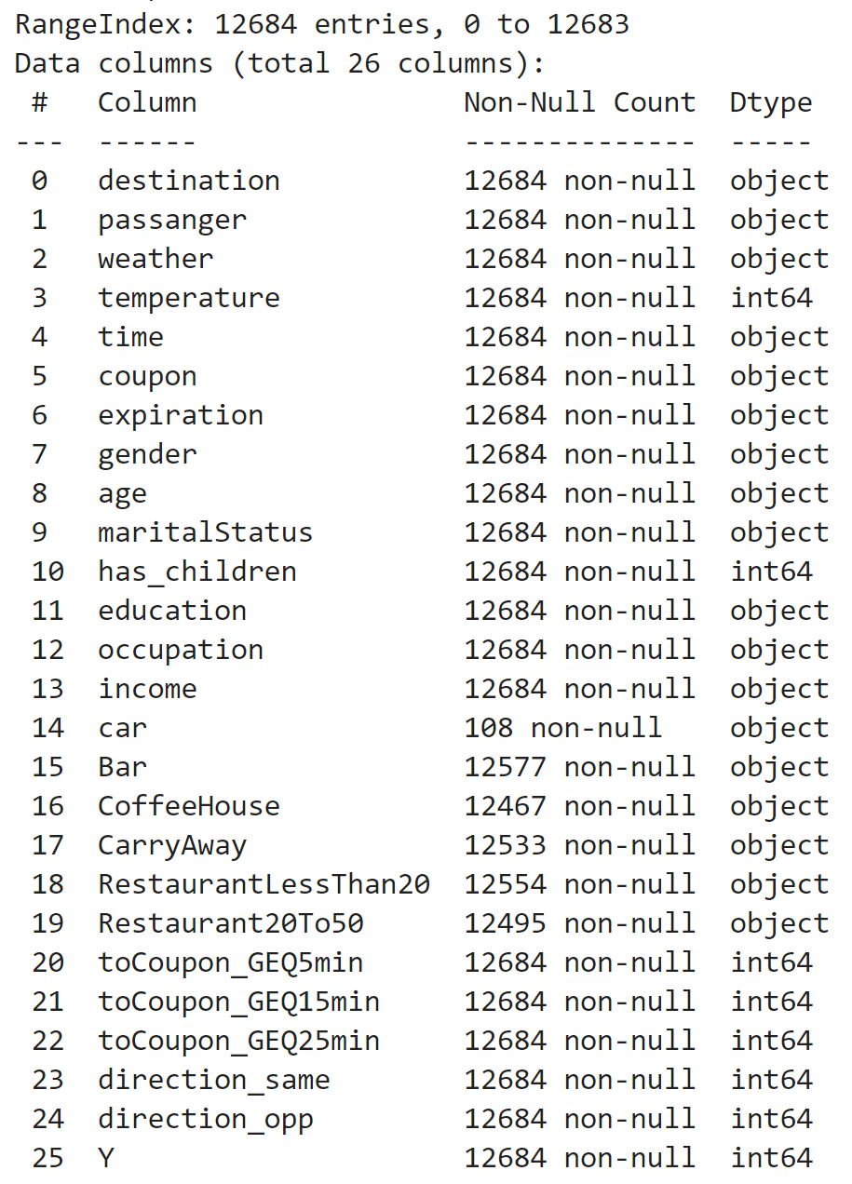
Data Exploration
Dataset contains numerical and categorical data
Steps in data cleaning and feature selection:
Remove null values
Eg: Attribute ‘car’ has 108 non-null values

Slide 4
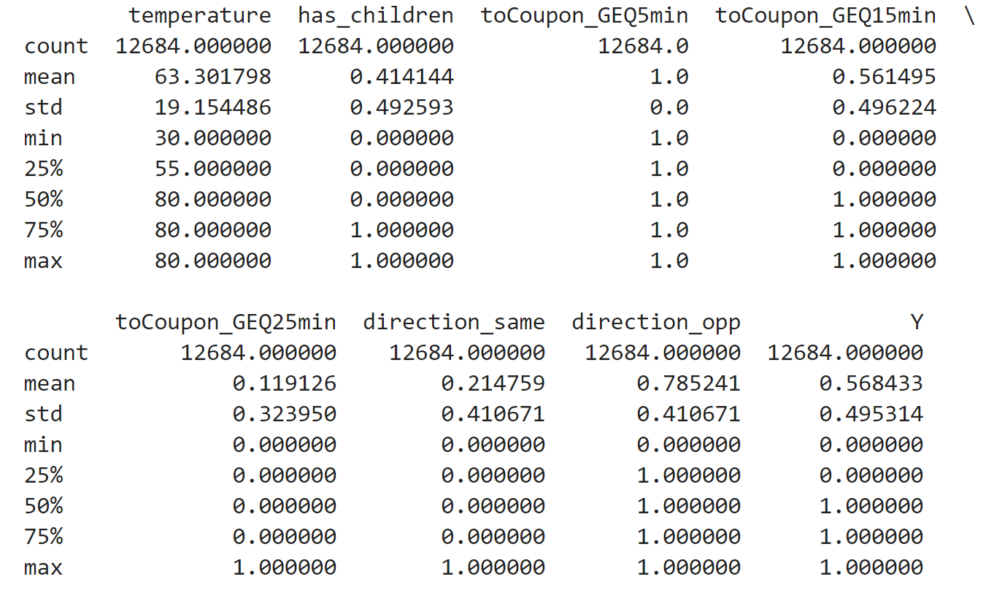
Dataset description
Basic descriptive statistics for all numeric columns
‘toCoupon_GEQ5min’ has only one value

Slide 5
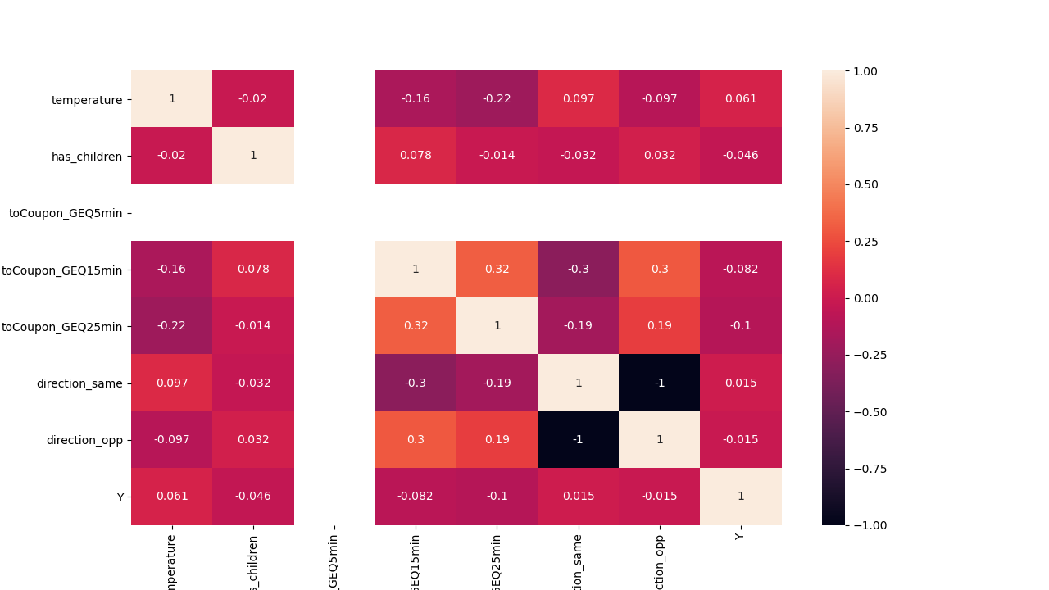
Correlation matrix
Depicts correlation between all the possible pairs of values in a table.
A powerful tool to summarize a large dataset and to identify and visualize patterns in the given data.
Direction_same and direction_opposite are inversely related.

Slide 6

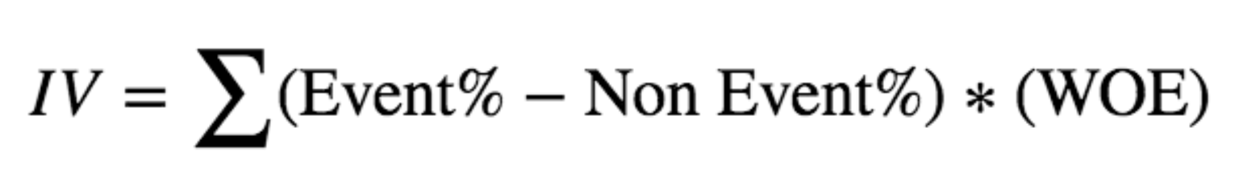
Weight of Evidence & Information Value
The weight of evidence measures the strength of each grouped attribute in predicting the desired value of the Dependent Variable
IV tells the predictive power of an independent variable in relation to the dependent variable.
Variable name | Non- event | Event | Non-event% | Event% | WOE | Event%-Non-event% | IV
Architecture & Engineering | 64 | 111 | 0.01230296 | 0.016140759 | 0.117914328 | 0.383779865 | 0.045253145
Arts Design Entertainment Sports & Media | 263 | 301 | 0.050557478 | 0.043769085 | -0.062617929 | -0.678839254 | 0.042507508
Building & Grounds Cleaning & Maintenance | 18 | 26 | 0.003460208 | 0.003780718 | 0.038472166 | 0.032051072 | 0.001233074
Business & Financial | 222 | 294 | 0.042675894 | 0.0427512 | 0.000765679 | 0.007530576 | 5.77E-06
Community & Social Services | 110 | 109 | 0.021145713 | 0.015849935 | -0.125194864 | -0.529577862 | 0.066300428
Computer & Mathematical | 597 | 771 | 0.114763552 | 0.11211284 | -0.01014863 | -0.265071258 | 0.00269011
Construction & Extraction | 48 | 106 | 0.00922722 | 0.015413698 | 0.222835951 | 0.618647753 | 0.137856961
Education&Training&Library | 416 | 439 | 0.079969243 | 0.063835975 | -0.097857487 | -1.613326761 | 0.157876102
Farming Fishing & Forestry | 20 | 23 | 0.003844675 | 0.003344482 | -0.060530836 | -0.050019352 | 0.003027713
Food Preparation & Serving Related | 120 | 156 | 0.023068051 | 0.02268431 | -0.007285324 | -0.038374073 | 0.000279568
Healthcare Practitioners & Technical | 63 | 159 | 0.012110727 | 0.023120547 | 0.280827898 | 1.100982011 | 0.309186464
Healthcare Support | 73 | 169 | 0.014033064 | 0.024574669 | 0.243335168 | 1.054160498 | 0.256514322

Slide 7
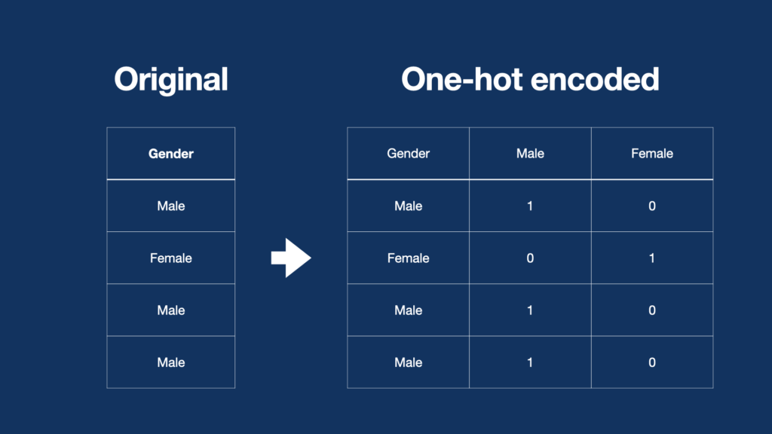
Encoding Data
To convert categorical data to numerical data
Used one hot encoding
It creates additional features based on the number of unique values in the categorical feature.
Every unique value in the category will be added as a feature.

Slide 8
Training and Test Data
The dataset is divided into two groups for training and testing data.
The training data is necessary to teach and train the models effectively to improve the accuracy score.
Over training or under training the data may lead to Overfitting / Underfitting.
After training the data, the data is now ready to be tested.
Test data is used to validate the progress of algorithm training and to adjust or optimize it for improved results.
Test data provides final check of unseen data to confirm the ML algorithm is trained effectively.

Slide 9
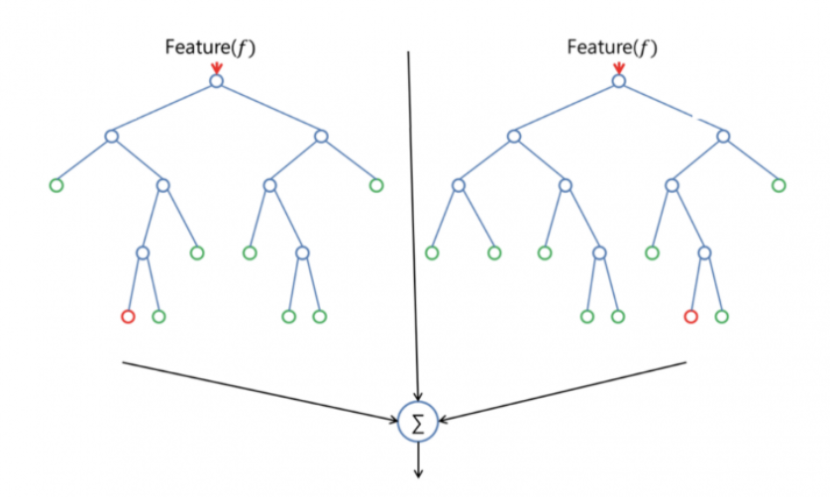
Random Forest
It is a supervised learning classification algorithm.
Builds multiple decision trees and merges them together to get accurate and stabilized prediction
The output data is predicted by comparing the outputs by taking mean or average from various decision trees.
Random forest can be used for both classification and regression problems.

Slide 10
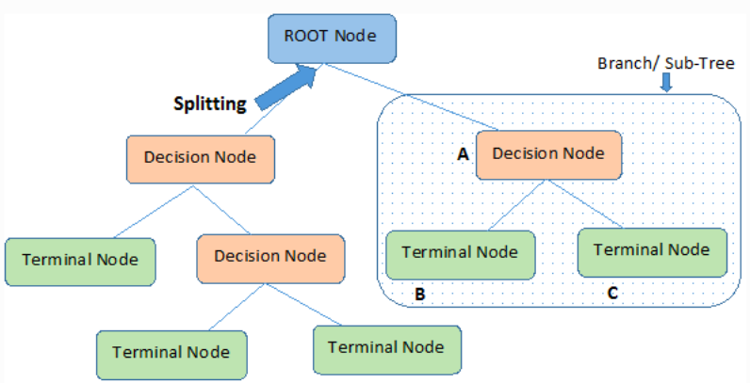
Decision Trees
It is a supervised learning classification algorithm
Uses multiple algorithms to split a node into two or more sub-nodes which separates all the labels or classes.
Predicts the output by learning simple decision rules from data features.
Decision trees can be used for both regression and classification problems.

Slide 11
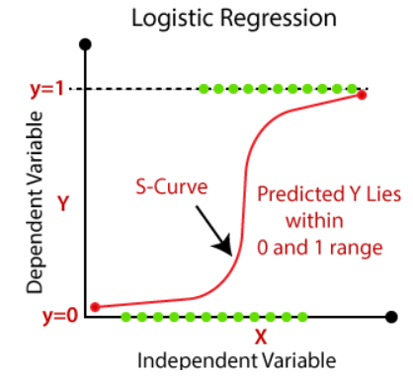
Logistic Regression
It is a supervised learning classification algorithm.
Used for predicting the categorical dependent variable using a given set of independent variables.
It is a statistical method which analyses the relationship between one or more independent variable and dependent variable by estimating probabilities.

Slide 12
Model Accuracy
Accuracy score for Random forest : 74.91 %
Accuracy score for Decision Trees: 66.41 %
Accuracy score for Logistic Regression: 68.62 %

Slide 13


Receiver Operating Characteristic Chart
The accuracy performance of all the three algorithms is compared using ROC (Receiver Operating Characteristic Chart) curve chart. It helps to present the performance of a classification model at all classification thresholds.
True Positive Rate
False Positive Rate
AUC stands for "Area under the ROC Curve." That is, AUC measures the entire two-dimensional area underneath the entire ROC curve.
It has values from 0 to 1.
0 for the 100% wrong predictions
1 for the 100% right predictions.

Slide 14
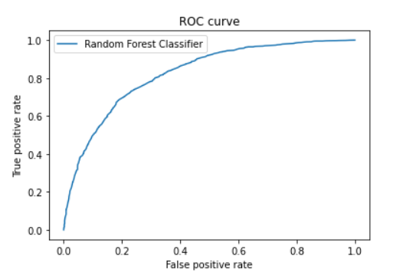
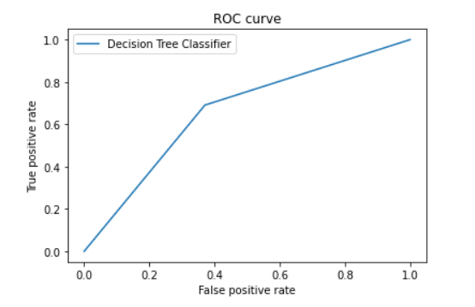
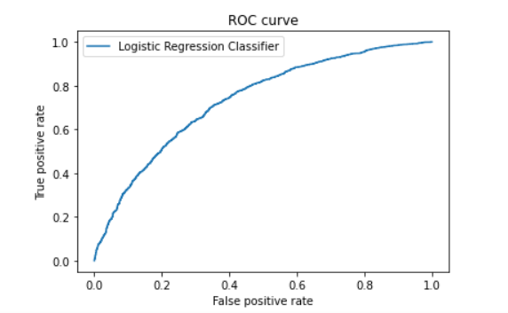
ROC Curves
RANDOM FOREST
DECISION TREE
LOGISTIC REGRESSION

Slide 15
Accuracy and Area Under the Curve(AUC)
Algorithms | Random Forest | Decision Tree | Logistic Regression
Accuracy Score | 0.7491721854304636 | 0.6641832229580574 | 0.6862582781456954
ROC AUC (Area Under the Curve) | 0.8248800269630124 | 0.6601024718156127 | 0.7335493157207967

Slide 16
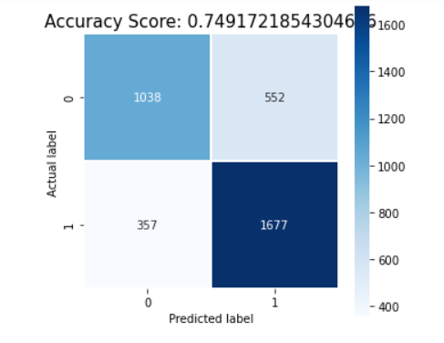
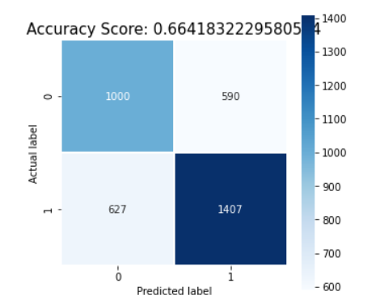
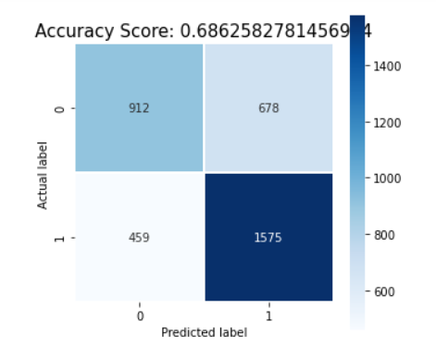
Confusion Matrix
Confusion Matrix is used to evaluate the quality of a classifier on the data set. The diagonal values represent the number of points for which the predicted label is equal to the true label and the false label, mislabeled elements by the classifier are labelled by off-diagonal elements.
RANDOM FOREST
DECISION TREE
LOGISTIC REGRESSION

Slide 17
Classification Table
The classification report visualizes the precision, recall and f1 score for the data model. The metrices are defined in the termed of True Positive and False Negatives. True positive is when the actual class and the estimated class both are true and whereas the false positive is when actual class is negative and estimated class is positive.
Precision: It is used to measure the classifier exactness and also the ratio of the true positives to the sum of true positive and true negatives.
Recall: It is used to measure the classifier completeness and also ratio of true positives to the sum of true positives and false negatives.
F1 score: The weighted average of F1 should be used to compare classifier models.
Support: It is the number of actual occurrences of the class in the dataset.

Slide 18
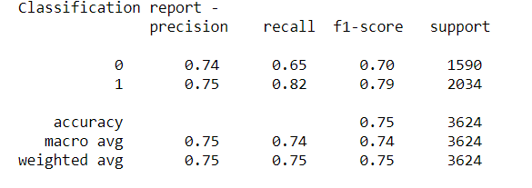
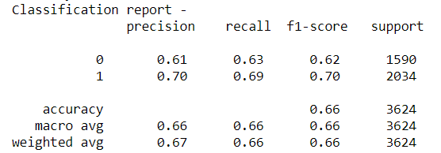
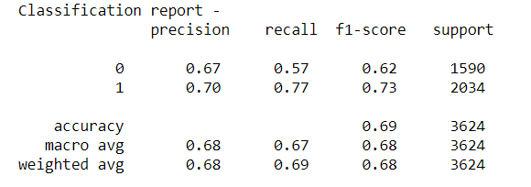
RANDOM FOREST
DECISION TREE
LOGISTIC REGRESSION

Slide 19
Conclusion
This project compares three machine learning algorithms on in-vehicle coupon recommendation dataset.
Random Forest, decision tree and logistic regression have been used for classification.
The Random Forest performs the classification more accurately than the other two algorithms. Therefore, Random Forest should be used to classify the coupon recommendation for the in-vehicle customers

Slide 20
References
T. Wang, C. Rudin, F. Velez-Doshi, Y. Liu, E. Klampfl and P. MacNeille, "Bayesian Rule Sets for Interpretable Classification," 2016 IEEE 16th International Conference on Data Mining (ICDM), 2016, pp. 1269-1274, doi: 10.1109/ICDM.2016.0171.
M. K. Dahouda and I. Joe, "A Deep-Learned Embedding Technique for Categorical Features Encoding," in IEEE Access, vol. 9, pp. 114381-114391, 2021, doi: 10.1109/ACCESS.2021.3104357.
A. Smirnov and N. Shilov, "Intelligent driver support: Integration of coupon services into on-board infotainment systems," 2014 International Conference on Connected Vehicles and Expo (ICCVE), 2014, pp. 1043-1044, doi: 10.1109/ICCVE.2014.7297506
Saeed Mirshekari, “Coupon Purchase Prediction” Competition in Kaggle, 2015.
Cheng Yeh a, Che-hui Lien, “The comparisons of data mining techniques for the predictive accuracy of probability of default of credit card clients” pp. 2473-2480, 2009, doi: 10.1016/j.eswa.2007.12.020.
https://scikit-learn.org/stable/auto_examples/model_selection/plot_confusion_matrix.html
https://www.scikit-yb.org/en/latest/api/classifier/classification_report.html
https://developers.google.com/machine-learning/crash-course/classification/roc-and-auc

